Slide 1
TECHNOLOGY MANAGEMENT AND ENTREPRENEURSHIP
Topic: selecting r and d projects
presented by:
kshema r gowda
impana S M

Slide 2
SELECTING R&D PROJECTS
Need for Selection
1.Sixty ideas (from researchers, other employees, customers, and suppliers) need to be screened quickly down to
2.Twelve ideas worthy of preliminary technical evaluation and analysis of profitability, to Produce
3.Six defined potential products worth further development, to obtain
4.Three prototypes for detailed physical and market testing, resulting in
5.Two products committed to full-scale production and marketing, of which
6.One product should be a real market success.

Slide 3
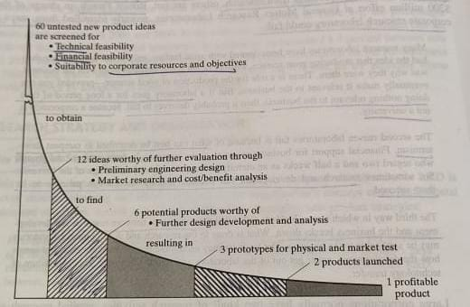
Screening of research project ideas

Slide 4
Initial Screening
Characteristics of initial screening
1.Technical factors
2.Research direction and balance
3.Timing
4. Stability
5. Position factor
6.Market growth factors for the product
7.Marketability and compatibility with current marketing goals, distribution methods, and customer makeup
8.Producibility with current production facilities and manpower
9. Financial factors
10.Patentability and the need for continuing defensive research

Slide 5
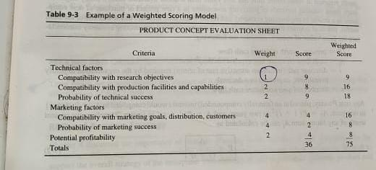

Slide 6
quantitative approaches
Quantitative methods emphasize objective measurements and the statistical, mathematical, or numerical analysis of data collected through polls, questionnaires, and surveys, or by manipulating pre-existing statistical data using computational techniques. For evaluating the financial proposed project typically they involve estimating the relationship between the investment required and the benefits to be gained. Easiest to calculate is the simple payback time
Tpb=I/A
Where I=which is the ratio of required investment
A=mean annual gross profit

Slide 7
Using the standard engineering economy nomenclature for time value of money, consider the following:
P= Aj/(1+i)j
P=present worth of future cash flow
Aj=cash flow (revenue less expense) in jth year
i=discount rate (minimum attractive rate of return) required by the organization to justify investment, expressed as a decimal
n=number of years of future cash

Slide 8
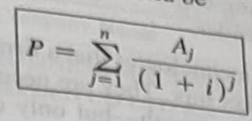
The present worth of a years of such cash flow would be:

Slide 9
MAKING R&D ORGANIZATIONS SUCCESSFUL
Three topics are treated herein: the relation of R&D strategy to business strategy, evaluating the effectiveness of R&D (both at the organizational and individual levels), and providing effective support for researchers.
1.R&D and Business Strategy
•Base technologies.
•Key technologies.
•Pacing technologies.
2.Evaluating R&D Effectiveness

Slide 10
Evaluating R&D Effectiveness
1.Organizational Effectiveness, Balderston etal. suggest the following 11 criteria for business enterprise R&D
1.Ratio of research costs to profits.
2. Percentage of total earnings due to new products.
3. Share of market due to new products.
4. Research costs related to increases in sales.
5. Research costs to ratio of new and old sales.
6. Research costs per employee.

Slide 11
7.Ratio of research costs to overhead expenses such as administrative and selling costs
8. Cash flows
9. Research audits, including indicators of administrative and technical objectives such as costs, time, completion dates, probability of technical success, probability of commercial success, expected market share, expected profits, expected return on investment, design, and development. Blake provides a checklist of questions to ask in such an audit.
10. Weighted averages of costs and objectives
11. Project profiles

Slide 12
2.Individual Effectiveness.
The effectiveness of individual researchers can be evaluated by the normal techniques of performance appraisal especially management by objectives (MBO), emphasizing research goals. A few quantitative measures such at the number of patents and publications, and citations by others of those publications, give limited insight into research effectiveness

Slide 13
Support for R&D
Quality supporting services need to be supplied to make the work of the highly trained scientist and engineer more efficient and productive. A few special types of assistance that are needed in research and engineering are listed as follows:
1.Technician support to carry out repetitive testing and other functions not requiring a graduate engineer or scientist
2.. Shop support of mechanics, glassblowers, and carpenters to produce test and research equipment based on researchers' sketches
3.A technical library with technical information specialists conversant in the fields of the 207 company's interest and willing and able to suggest sources to researchers, and structure and run searches in the appropriate databases for them
4. Technical publication support, including typing, editing, and graphical support to simplify researchers' production of reports, technical papers, and presentation.

Slide 14
5. A flexible, responsive system for approving and acquiring equipment as needed by researchers
6. Ample computer facilities conveniently available to researchers, and programming assis –-tance to provide consultation and programming to those researchers not wishing to do it themselves
7. A strong internal commercialization process in place to take research to product

Slide 15
THANK YOU

